Slide 1



Mixipe – Recipe Finder App
Sasha Kuechenmeister
C18404082
Tu857
Supervisor: Anh Duong Trinh

Slide 2
Project Idea
Create a recipe finder app using tinder-like swipeable mechanism.
1/3 of millennials find searching for recipes tedious
Find new recipes in a fun, addicting and less tedious way
Notes:
The idea for my project is to create a recipe finder app using a tinder-like swipeable mechanism. Users will be shown a random recipe on which users can then swipe right or left to like or dislike the recipe. If a user likes the recipe, it will be saved to their “liked” list and if a user disliked the recipe it wont be shown to them again for a certain period of time.
The reason I'm creating this app is because I saw a study that suggests 1/3 of millennials find searching for what to cook tedious and its their least favourite part of the cooking process.
Therefore Mixipe is being developed so that searching for recipes can be fun and addicting. In other words, Mixipe is supposed to be a solution to this “boring” process.

Slide 3
research
Existing solutions
Platform selection
Mobile technologies
Databases
APIs
Notes:
For this project I've conducted a lot of research on some of the existing solutions, what platform is suited best for this project, which mobile technologies to use, databases, and api’s.
From this research I was able to come up with what I believe is best suited for this project.

Slide 4
existing solution
ShuffleChef
Meal planning app.
Pros:
Makes discovering recipes enjoyable through its swiping mechanism.
Cons:
Cannot view any detailed information (ingredients, instructions, etc) within the app.
User are forced to like a recipe before being able to see more information.
Notes:
Firstly I looked at some existing solutions and I found an app quite similar to what I'm envisioning, which is called ShuffleChef.
It is a Breakfast, lunch, and dinner meal planning app which uses a swipeable mechanism to like and dislike recipes.
The pros of this app is that it makes discovering recipes more enjoyable and quite addicting through the swiping feature.
However some of the main issues I found with the app were that you cannot view any detailed information (such as what ingredients are used, or if a recipe is vegan or even contains common allergerns) within the app. For some reason users have to click on a link which brings them to a browser webpage instead where they can view all the information.
Furthermore, users are basically forced to like a recipe before being able to see more information as previously mentioned which in my option is very poorly designed as someone who is vegan wont know what ingredients are used in a recipe until they like it.
For my project I aim to avoid these issues so that it becomes more user-friendly.

Slide 5
Platform selection
Smartphone
55.35% market share
More and more people using smartphones rather than desktops
Easier access
Notes:
Smartphone
Smartphones have the largest market share of 55.35% compared to desktops 44.65%.
As smartphones get more advanced each year, the dynamic of internet use is continuingly shifting more from PCs to mobile devices.
Also seeing as this application is meant to be used in the kitchen a lot of the time, smartphones offer much easier access than a laptop for example.

Slide 6
Mobile technologies
Android
Android 71% vs iOS 28% mobile OS market share .
Android one-time $25 vs iOS annual $99 to publish applications on the official marketplace
Language - Java
Software - Android Studio
Notes:
The chosen mobile operating system for this project is android developed by google.
Android has a much larger share than its counter-part iOS developed by Apple. It makes up over 71% of the market share compared to iOS’s 28%.
On top of that, android developers only have to a pay a one-time fee of $25 to publish their apps to the official marketplace whereas iOS developers have to make an annual payment of $99.
Another reason why Android was chosen is because its applications are usually developed using Java through Android studio, and seeing as I’ve a good bit of experience with both it was the more obvious choice.

Slide 7
database
Firebase
Real-time database management system.
Backed by Google.
Cloud-hosted.
No internet connection required
Notes:
The database chosen for this project is Firebase
Firebase is a real-time database management system which is backed by Google. It is cloud-hosted which means that developers can easily perform scaling without any problems. It also means that Firebase does not require an active internet connection when users enter data, instead Firebase saves the data and uploads in once users regain access to an internet connection. Chosen because it is easy to implement in Android Studio. And as it does not need a stable internet connection when users enter data, Mixipe users can still use the application even when their internet connection is unstable.

Slide 8
Application programming interfaces
Spoonacular API
Access to 360,000 recipes.
Open-source database.
Uses natural language.
Automatically analyses recipes for a common allergens.
Display if recipe is vegan, vegetarian, paleo-friendly, etc.
Other features include randomising recipes, extract ingredients from recipes, and visualize nutritional data.
Notes:
Spoonacular has access to over 360,000 recipes and includes an open-source recipe database, meaning anyone can add their recipes to the list. Similarly to the Webknox API it allows users to use natural language to search for a recipes. Spoonacular also automatically analyses recipes to check for ingredients that may contain common allergens, such as wheat or dairy. It also allows users to see if a recipe is vegan, vegetarian, paleo friendly, and more. Other features that it provides are the ability to recommend recipes, find random recipes, extract ingredients from the recipe instruction steps, and visualize recipe nutritional data.

Slide 9
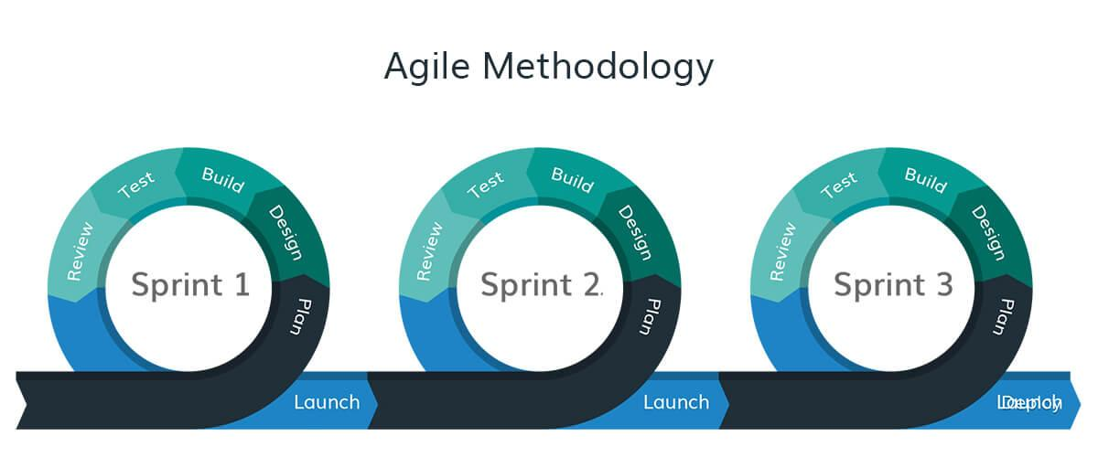
Software Methodology
Agile Methodology
Feature Driven Development (FDD)
Notes:
The software methodology used for this project is the Agile methodology. Which is basically managing the project by dividing it up into smaller phases or “sprints”. After each sprint is completed, the project priorities are assessed and any adjustments that are judged essential are implemented. This methodology is very feature driven so each feature will be developed one after the other and thoroughly tested after each has been completed. This will make it easier to detect any flaws that arise and also reduces the amount of time spent debugging at the end of production.

Slide 10
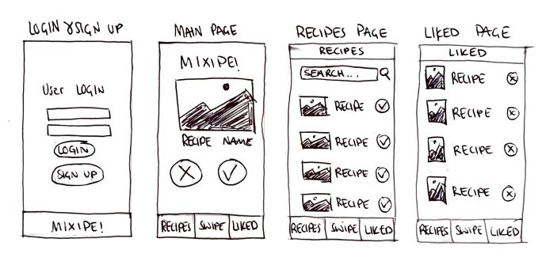
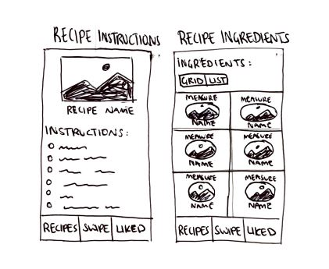
System Design

Slide 11
Testing
Unit Testing
Blackbox Testing
Manual Testing
Notes:
Testing will be a very important part of this project to ensure that any bugs or issues can be fixed before the app is published.
The three types of testing that will be used are unit testing, Blackbox testing, and manual testing.
Unit testing is the process of creating tests that interact with the application directly. These tests will guarantee that every component of the software is working properly.
Blackbox testing will also be utilized to test the concept from a different perspective. The tester will have no knowledge of the items internal structure, design, or implementation. The black box testing approach will look for flaws in areas like interface, performance, incorrect functions, initialization, and more.
Manual testing will also take place, in which the developer will assume the role of the end user and evaluate the app’s feature to guarantee its behaviour.

Slide 12
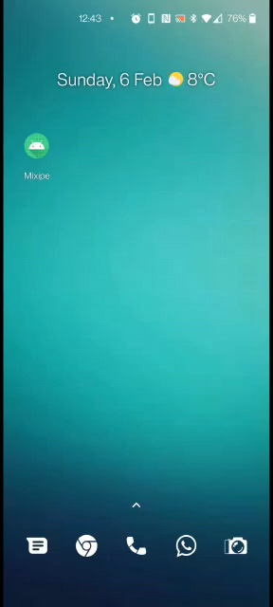
Mixipe Demo

Slide 13


